Slide 1
Speedy MINX Results
Prepared by: Elisa Dong
Feb 28, 2018

Slide 2
Goals
Comparison for plumes retrieved by MINX and model plumes
Get useful stats in comparison
Check if current definition of plume from model is actually accurate

Slide 3
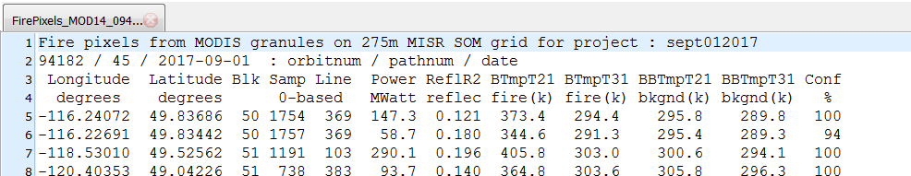
preMINX Processing
Using AB/SK area during Sept 1-15, 2017
Retrieved results using preMINX
Filtered FirePixels text file using
1. Top 10% in Power (MWatts), greater than 60% Confidence
2. Top 20% in Power (MWatts), greater than 50% Confidence
Notes:
By default, MINX only displays orbits with a certain amount of total firepower. By default, the confidence level needs to be > 40% to show up on MINX.
I left the original Fire Pixels text files alone and created new files for overlay in MINX in a separate location.
The goal of this is to reduce the total number of fires needed to be digitized and to only digitize those of interest (the two categories).

Slide 4
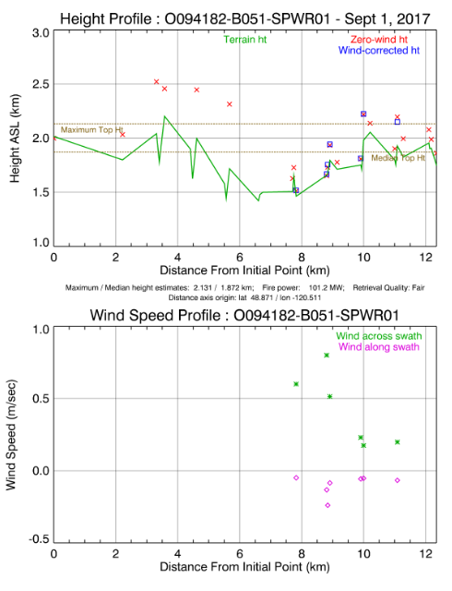
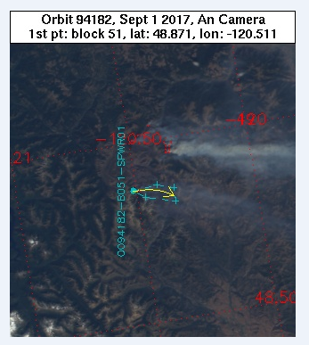
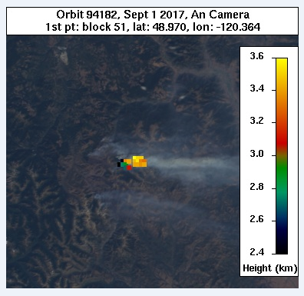
Digitizing in MINX
Display customized FirePixels overlay
Select plumes based on
Not under lots of cloud cover
Quality: Fair or Good
Roughly within 10km from origin
Notes:
Steps:
Find plume using firepixel (red dot)
Digitize by circling the plume and providing wind direction, or drawing a line (only include parts less than ~10km away)
Check MINX results to see if the Quality: Poor (throw away if it is, or redigitize)
Results: get a bunch of plume objects

Slide 5
postMINX Processing
Sorted red and blue band plume results
Used the red band results if the terrain was not visible below the plume
Otherwise used blue band results
From MINX article, doi:10.3390/rs5094593:
stereo retrieval coverage deteriorates dramatically as wavelength increases
In certain cases, the greater sensitivity of the blue band to thinner aerosols allows aerosol features to be matched that correspond to a higher altitude for the plume.
NOTE: default MINX uses both red and blue bands to image match, I picked either the blue or red band results afterwards. This should have the same effect.
speedyAltMINXdemo.py (apply to one plume)
loopSpeedMINX.py (apply to all plumes)
FST files, high resolution (for comparisons)
Produced:
MINX plumes: colour, contour, direction, histogram, polynomial fit, scatter, shape and surface plots, basic stats (max, min, median, mean, std)
MINX and Model plumes: colour, contour, histogram, polynomial fit, and scatter plots
All plumes together: basic stats (total max/min, RMSD, correlation coefficient, mean bias), MINX plume and model plume comparison plot
Notes:
Sorted plume results. Used the results that matched aerosol cover situation.
Wrote two scripts, one to take advantage of all the plotting functionality and treatment of plumes as objects. The other to repeat and accumulate information such as plume height and model plume height.
Low res FST files can also be compared against, just haven’t added in the AF values yet
Note that the basic stats for all the plumes has max, min. This is just a check to see that the comparison plot is correct and does not provide any other information for individual plumes.
Extra Note: Not all plots will always be produced. Since I didn’t write the postMINX program, I’m not sure why, but warnings will appear for certain plots on terminal.

Slide 6
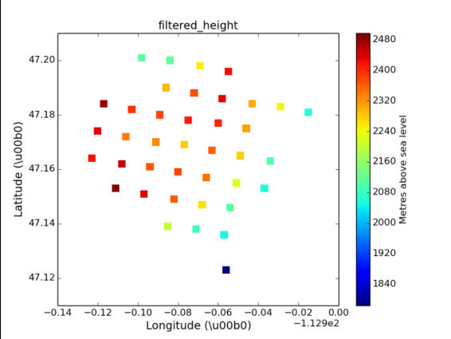
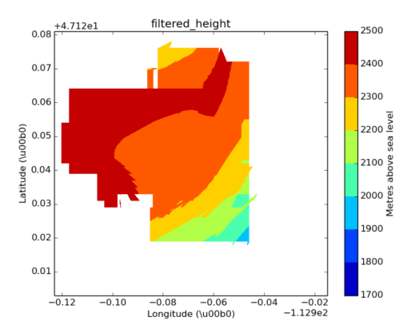
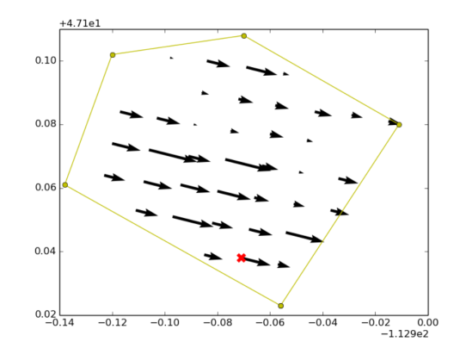
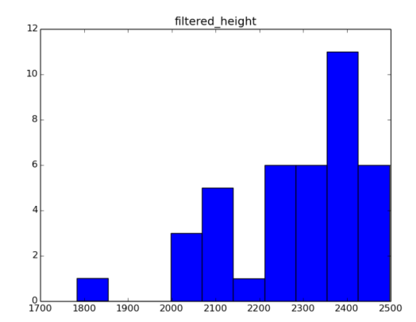
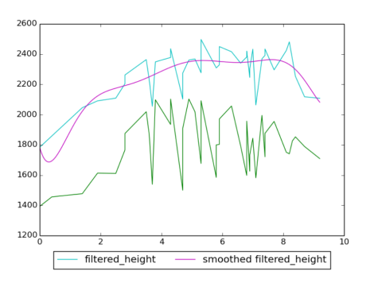
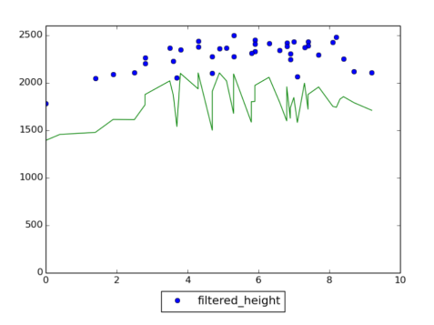
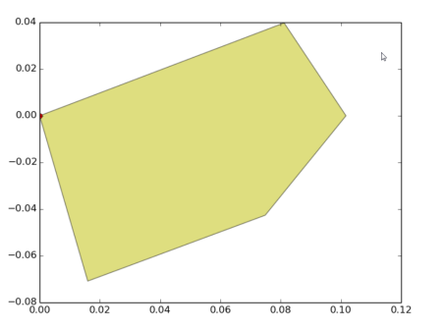
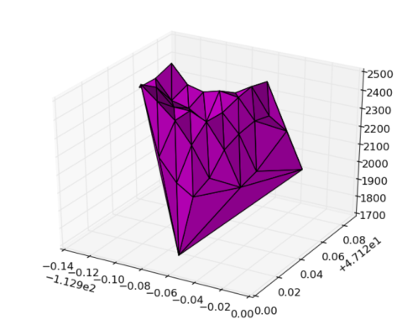
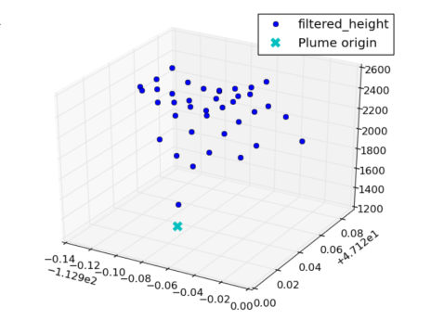
Sample Results – MINX Plume
Notes:
colour, contour, direction, histogram, polynomial fit, scatter, shape and surface plots, basic stats (max, min, median, mean, std)
Results: https://hpfx.science.gc.ca/~eld001/MINXResults/sept_01_15/p80_c50/thresh4/postAltOutputs/O094240-B053-SPWR01_HighRes/

Slide 7
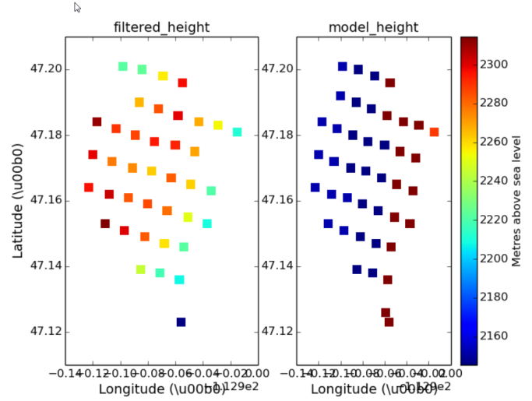
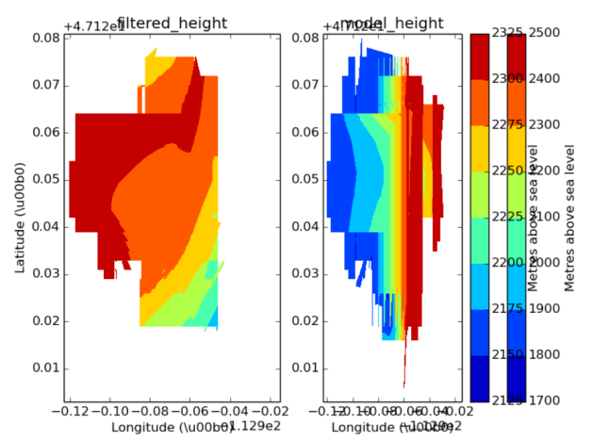
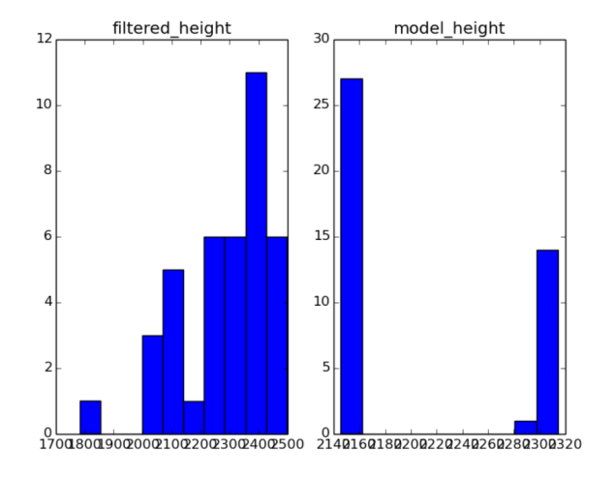
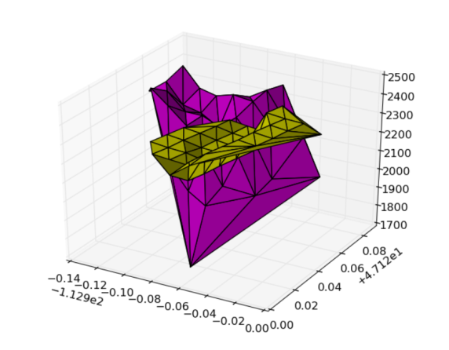
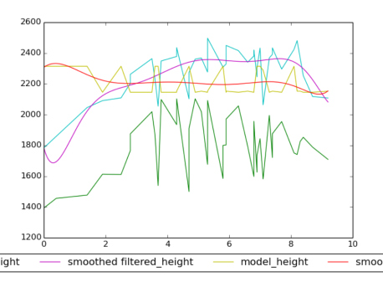
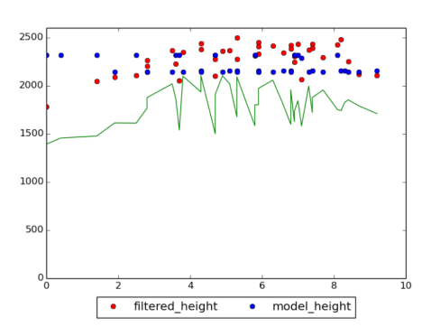
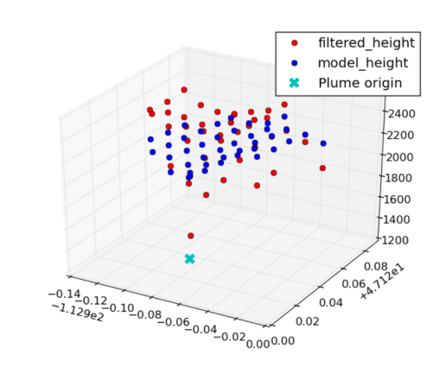
Sample Results – MINX and Model Plume
Notes:
MINX and Model plumes: colour, contour, histogram, polynomial fit, and scatter plots
NOTE: shape also produced, but it looks exactly the same as the one produced from the MINX plume
https://hpfx.science.gc.ca/~eld001/MINXResults/sept_01_15/p80_c50/thresh4/postAltOutputs/O094240-B053-SPWR01_HighRes/

Slide 8
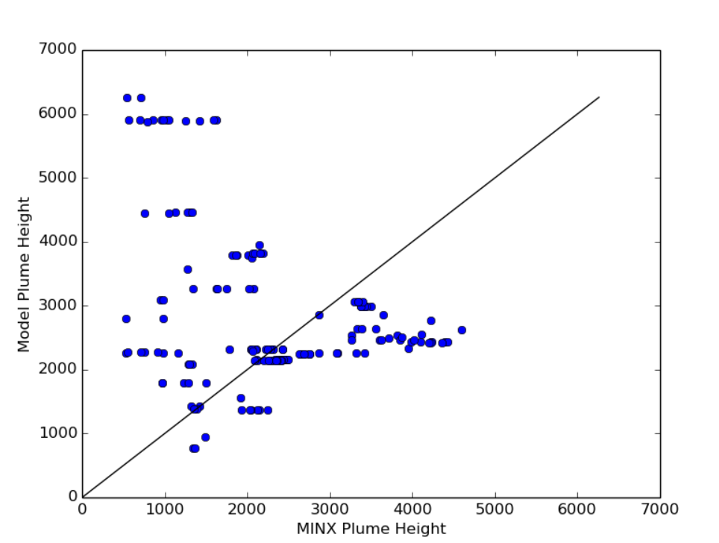
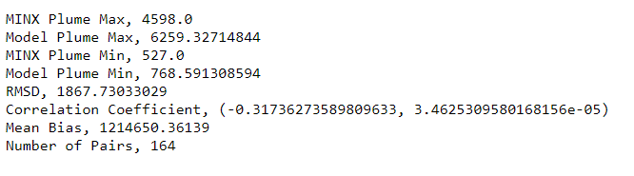
Sample Results – All Plumes
Notes:
https://hpfx.science.gc.ca/~eld001/MINXResults/sept_01_15/p80_c50/thresh15/
Note to self: redo the stats for thresh4, missing the number of pairs

Slide 9
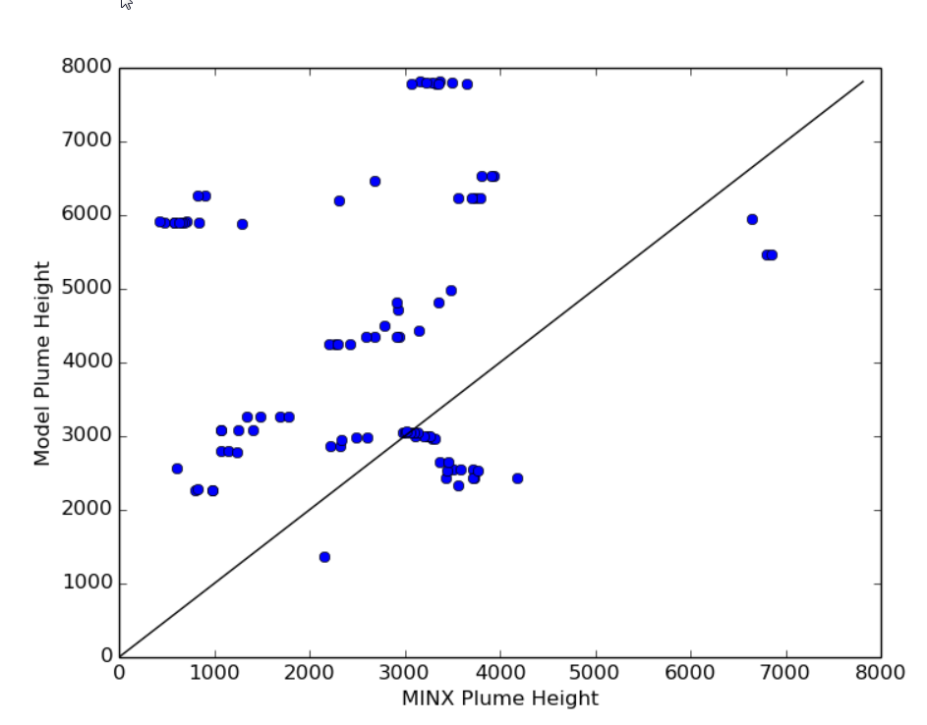
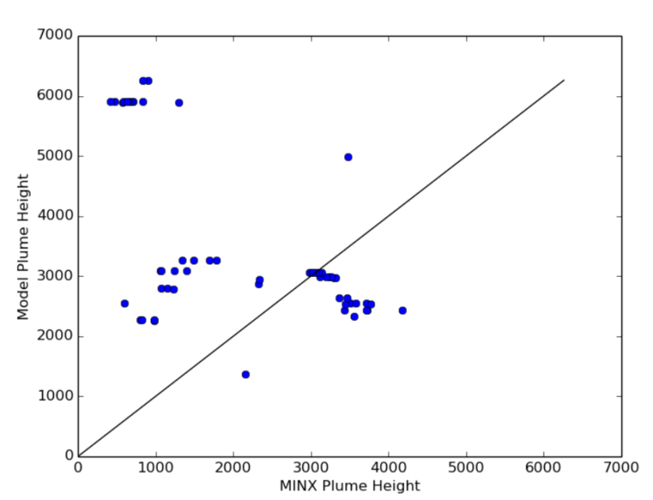
Results for Case 1 (P90, C60)
Threshold = default = 4
RMSD, 2720.24617395
Correlation Coefficient, (0.11845588056825707, 0.25549033571820351)
Mean Bias, 3176143.78634
Threshold = 15
RMSD, 2635.61288679
Correlation Coefficient, (-0.56235304904112915, 5.3018125518963431e-06)
Mean Bias, 1807981.51358
Number of Pairs, 57
Notes:
Note Correlation Coefficients
Significantly better when cutting out lower values of PM2.5
https://hpfx.science.gc.ca/~eld001/MINXResults/sept_01_15/p90_c60/

Slide 10
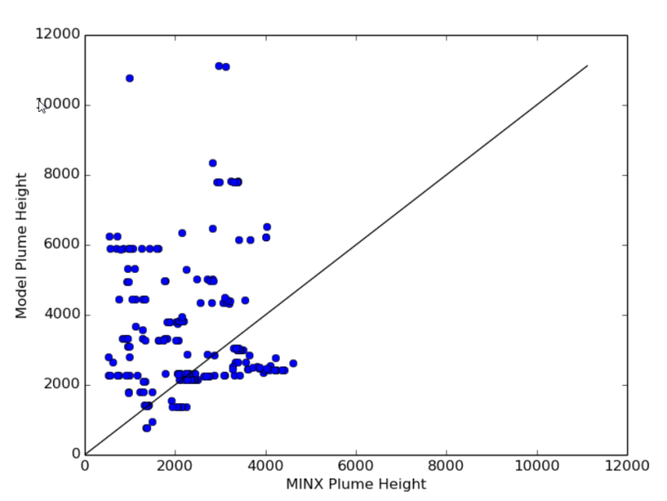
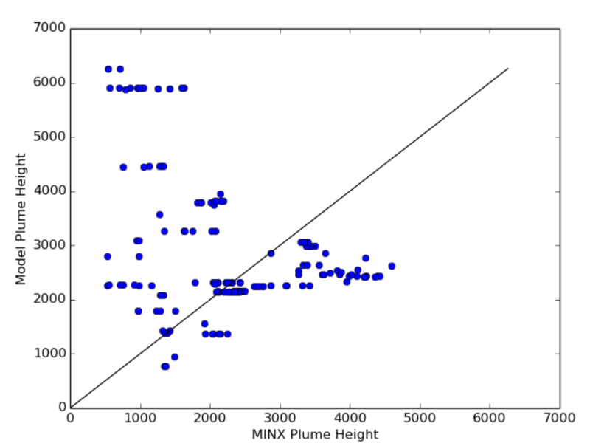
Results for Case 2 (P80, C50)
Threshold = default = 4
RMSD, 2415.7960233
Correlation Coefficient, (0.0084792036678869188, 0.90139646216419811)
Mean Bias, 2676414.46297
Threshold = 15
RMSD, 1867.73033029
Correlation Coefficient, (-0.31736273589809633, 3.4625309580168156e-05)
Mean Bias, 1214650.36139
Number of Pairs, 164
Notes:
Correlation also better when threshold is higher, but overall has gone down compared to case 1
Should probably check if it’s the percentile, or the confidence levels
https://hpfx.science.gc.ca/~eld001/MINXResults/sept_01_15/p80_c50/

Slide 11
Blue and Red Bands
Ran additional cases
If digitizer doesn’t know how to classify red/blue
Using the same 2 conditions, threshold = 15, Processed:
All blue band plume results
All red band plume results
Notes:
Note: It’s a little subjective as to whether or not the results should be in the blue or red band.
MINX can output both.
The following pages evaluate in the case of AB/SK during sept1-15, which band to use always if unsure how to categorize
NOTE: results may be skewed. Will have to check, but usually more plumes that should be viewed in red band.

Slide 12
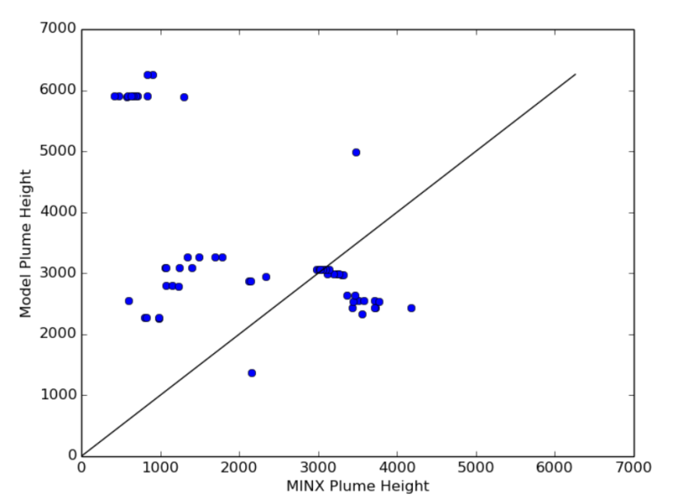
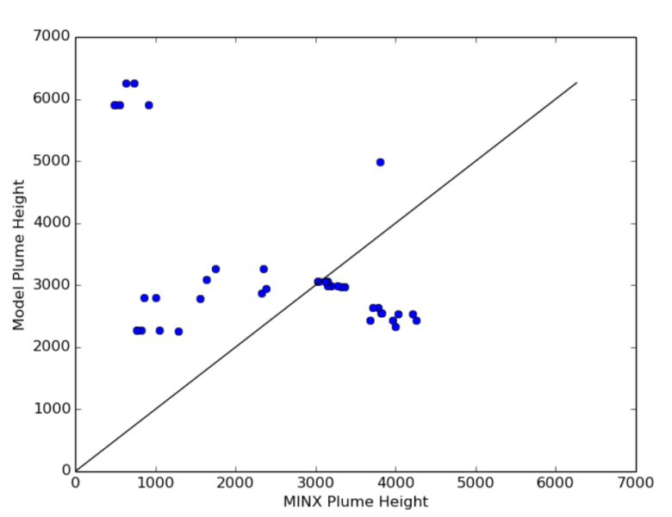
Results for Case 1 (P90, C60)
Red Band Plumes
RMSD, 2615.38515849
Correlation Coefficient, (-0.5601613690230256, 4.8245153034138419e-06)
Mean Bias, 1811570.28575
Number of Pairs, 58
Blue Band Plumes
RMSD, 2346.52238071
Correlation Coefficient, (-0.48455015807666041, 0.001532602190660252)
Mean Bias, 1084959.07057
Number of Pairs, 40
Notes:
General pattern and correlation is roughly the same. This is expected since the same plumes were processed.

Slide 13
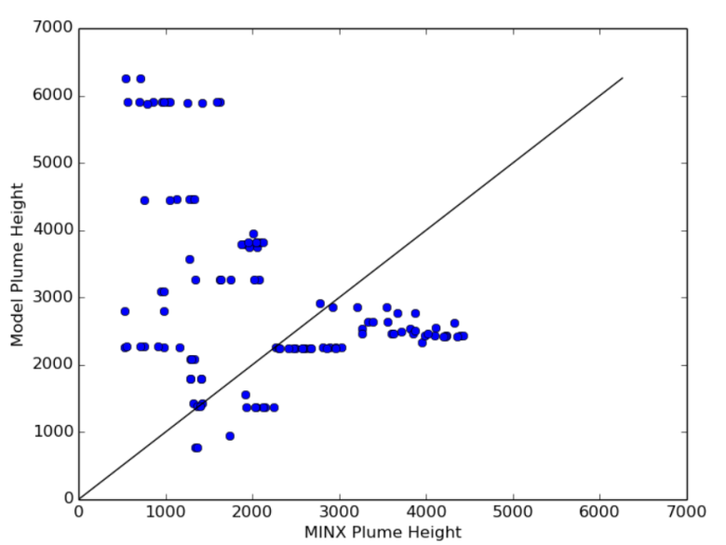
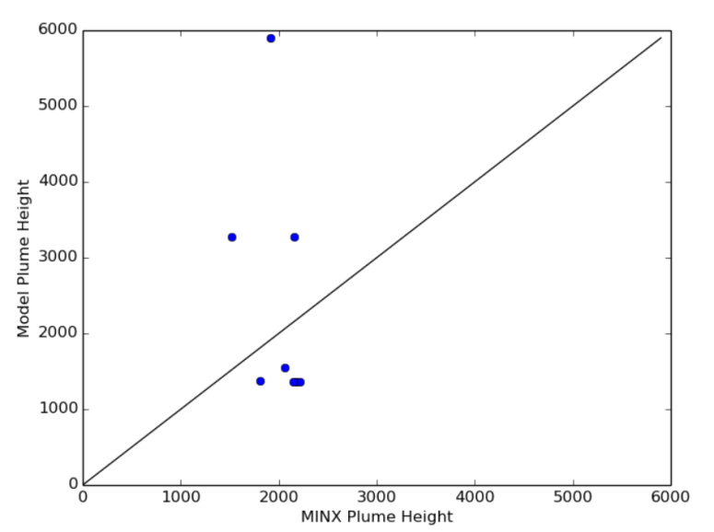
Results for Case 2 (P80, C50)
Red Band Plumes
RMSD, 2197.17999412
Correlation Coefficient, (-0.36147195144609651, 6.222726409088604e-05)
Mean Bias, 1405047.73982
Number of Pairs, 117
Blue Band Plumes
RMSD, 1681.96838944
Correlation Coefficient, (-0.36208131455134307, 0.37810112306164534)
Mean Bias, 435233.486629
Number of Pairs, 8
Notes:
Note that red band has more matches though. Ie. MINX results for blue band likely results in greater number of missing values for the plume objects.

Slide 14
Next Steps
Do a few more cases (vary percentile and confidence, more days if available)
Incorporate observational data (from hotspots)
Ideally find fires longer than one day
Compare model predictions, satellite values and reported values
Check that reported values are actually matching up to satellite values
May find that satellite and hotspot info don’t match up, would expected model to be off as well…

Slide 15
All Results
Link to results: https://hpfx.science.gc.ca/~eld001/MINXResults/sept_01_15/

